Slide 1
Unit -3
Forecasting Numeric Data –
Regression Methods

Slide 2
Mathematical relationships help us to understand many aspects of everyday life. For example, body weight is a function of one's calorie intake, income is often related to education and job experience, and poll numbers help us estimate a presidential candidate's odds of being re-elected.

Slide 3
When such relationships are expressed with exact numbers, we gain additional clarity. For example, an additional 250 kilocalories consumed daily may result in nearly a kilogram of weight gain per month; each year of job experience may be worth an additional $1,000 in yearly salary; and a president is more likely to be re-elected when the economy is strong.

Slide 4
Regression
Regression is concerned with specifying the relationship between a single numeric dependent variable (the value to be predicted) and one or more numeric independent variables (the predictors). As the name implies, the dependent variable depends upon the value of the independent variable or variables. The simplest forms of regression assume that the relationship between the independent and dependent variables follows a straight line.

Slide 5
You might recall from basic algebra that lines can be defined in a slope-intercept form similar to y = a + bx. In this form, the letter y indicates the dependent variable and x indicates the independent variable. The slope term b specifies how much the line rises for each increase in x. Positive values define lines that slope upward while negative values define lines that slope downward. The term a is known as the intercept because it specifies the point where the line crosses, or intercepts, the vertical y axis.

Slide 6
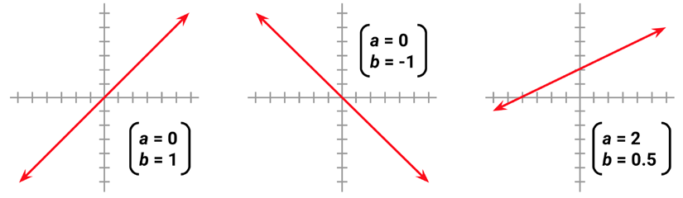

Slide 7
Regression analysis is commonly used for modeling complex relationships among data elements, estimating the impact of a treatment on an outcome, and extrapolating into the future. Some uses are:
Examining how populations and individuals vary by their measured characteristics, for use in scientific research across fields as diverse as economics, sociology, psychology, physics, and ecology
Quantifying the causal relationship between an event and the response, such as those in clinical drug trials, engineering safety tests, or marketing research

Slide 8
Identifying patterns that can be used to forecast future behavior given known criteria, such as predicting insurance claims, natural disaster damage, election results, and crime rates

Slide 9
Simple Linear Regression
On January 28, 1986, seven crew members of the United States space shuttle Challenger were killed when a rocket booster failed. In the aftermath, experts focused on the launch temperature as a potential culprit. The rubber O-rings responsible for sealing the rocket joints had never been tested below 40ºF (4ºC) and the weather on the launch day was unusually cold and below freezing. With the benefit of hindsight, the accident has been a case study for the importance of data analysis and visualization. Although it is unclear what information was available to the rocket engineers and decision makers leading up to the launch, it is undeniable that better data, utilized carefully, might very well have averted this disaster.

Slide 10
The rocket engineers almost certainly knew that cold temperatures could make the components more brittle and less able to seal properly, which would result in a higher chance of a dangerous fuel leak. However, given the political pressure to continue with the launch, they needed data to support this hypothesis. To build the regression model, scientists might have used the data on launch temperature and component distresses from 23 previous successful shuttle launches.

Slide 11
Since the shuttle has a total of six primary O-rings, up to six distresses can occur per flight. Though the rocket can survive one or more distress events, or fail with as few as one, each additional distress increases the probability of a catastrophic failure.
The following scatterplot shows a plot of primary O-ring distresses detected for the previous 23 launches, as compared to the temperature at launch:

Slide 12
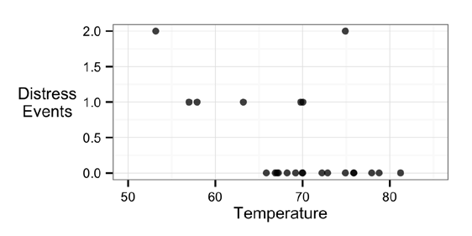

Slide 13
Examining the plot, there is an apparent trend. Launches occurring at higher temperatures tend to have fewer O-ring distress events. Additionally, the coldest launch (53º F) had two distress events, a level which had only been reached in one other launch. With this information at hand, the fact that the Challenger was scheduled to launch at a temperature over 20 degrees colder seems concerning.
Suppose we know that the estimated regression parameters in the equation for the shuttle launch data are: a = 3.70 and b = -0.048. Hence, the full linear equation is y = 3.70 – 0.048x.

Slide 14
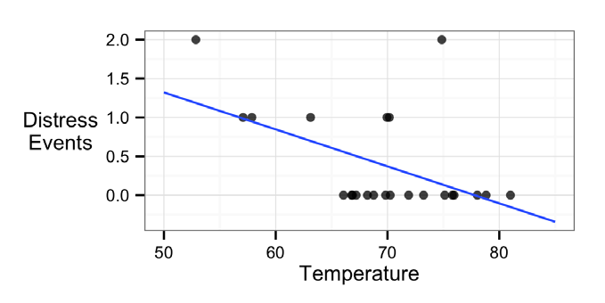

Slide 15
As the line shows, at 60 degrees Fahrenheit, we predict just under one O-ring distress. At 70 degrees Fahrenheit, we expect around 0.3 failures. If we extrapolate our model, all the way to 31 degrees—the forecasted temperature for the Challenger launch—we would expect about 3.70 - 0.048 * 31 = 2.21 O-ring distress events. Assuming that each O-ring failure is equally likely to cause a catastrophic fuel leak means that the Challenger launch at 31 degrees was nearly three times more risky than the typical launch at 60 degrees, and over eight times more risky than a launch at 70 degrees.

Slide 16
Ordinary Least Square Estimation
In order to determine the optimal estimates of α and β, an estimation method known as Ordinary Least Squares (OLS) was used. In OLS regression, the slope and intercept are chosen so that they minimize the sum of the squared errors, that is, the vertical distance between the predicted y value and the actual y value. These errors are known as residuals, and are illustrated for several points in the following diagram:

Slide 17
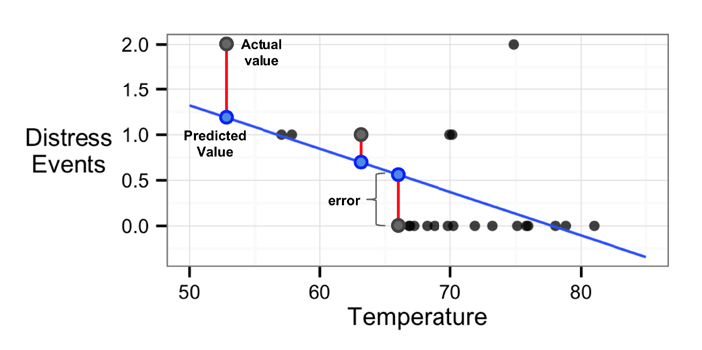

Slide 18
In mathematical terms, the goal of OLS regression can be expressed as the task of minimizing the following equation:
In plain language, this equation defines e (the error) as the difference between the actual y value and the predicted y value. The error values are squared and summed across all the points in the data.

Slide 19


Slide 20
Correlation
The correlation between two variables is a number that indicates how closely their relationship follows a straight line. Without additional qualification, correlation typically refers to Pearson's correlation coefficient, which was developed by the 20th century mathematician Karl Pearson. The correlation ranges between -1 and +1. The extreme values indicate a perfectly linear relationship, while a correlation close to zero indicates the absence of a linear relationship.

Slide 21
Multiple linear regression
Most real-world analyses have more than one independent variable. Therefore, it is likely that you will be using multiple linear regression for most numeric prediction tasks. The strengths and weaknesses of multiple linear regression are shown in the following table:

Slide 22
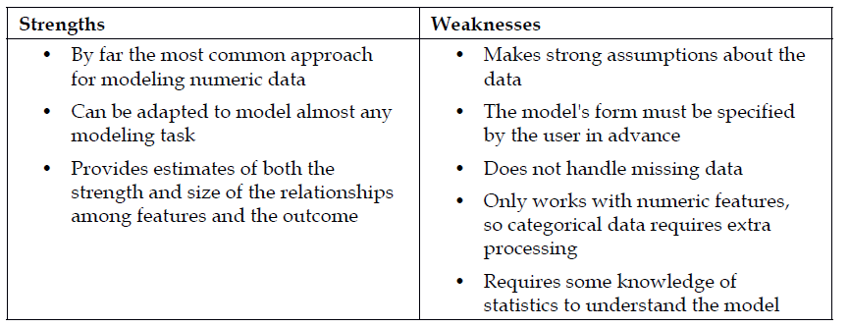

Slide 23
It is the most common form of Linear Regression. Multiple Linear Regression basically describes how a single response variable Y depends linearly on a number of predictor variables.
The basic examples where Multiple Regression can be used are as follows:
The selling price of a house can depend on the desirability of the location, the number of

Slide 24
bedrooms, the number of bathrooms, the year the house was built, the square footage of the lot and a number of other factors.
The height of a child can depend on the height of the mother, the height of the father, nutrition, and environmental factors.

Slide 25
Polynomial Regression
Polynomial regression is a special case of Linear regression where the relationship between X and Y is modeled using a polynomial, rather than a line.
Polynomial Linear Regression is similar to the Multiple Linear Regression but the difference is, in Multiple Linear Regression the variables are different whereas in Polynomial Linear Regression, we have the same variable but it is in a different power.

